Slide 1
Stock Price Prediction Using Historical Data and Twitter Sentiments
San Jose State University | Department of Computer Science
Data Mining | CMPE-255 | Professor David C. Anastasiu
Fall 2017
Team Members
Manika Kapoor
Masi Nazarian
Sowmya Gowrishankar

Slide 2
Outline
Introduction and Motivation
Datasets
Data Preprocessing
Algorithms Used
Evaluation
Conclusion | Demo

Slide 3
Introduction
Stock Market Prediction
Complex Problem involving seasonality/ trend in the data
Problems Addressed:
Finding the best model to predict Stock Prices using historical price data
Correlation between twitter sentiments and stock price fluctuation

Slide 4
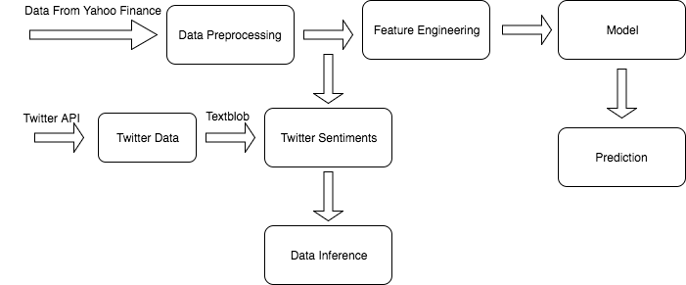
Flow Diagram

Slide 5
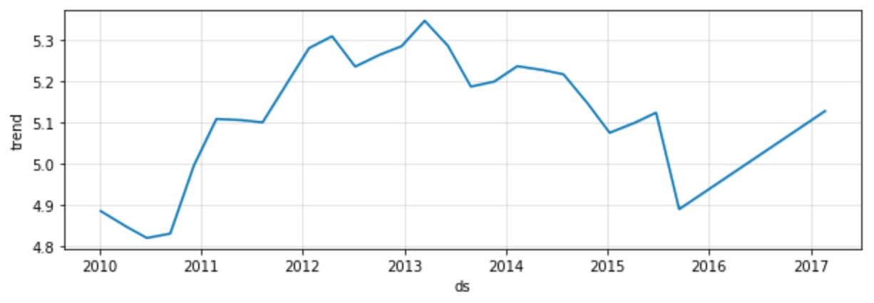
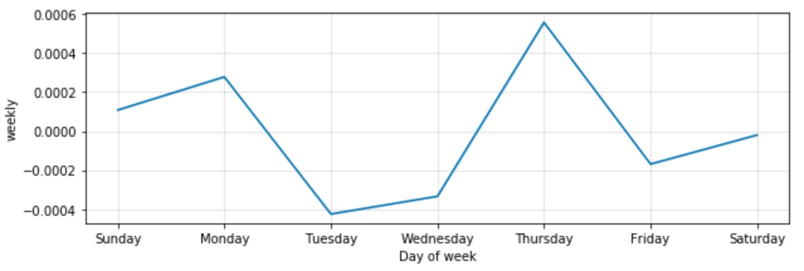
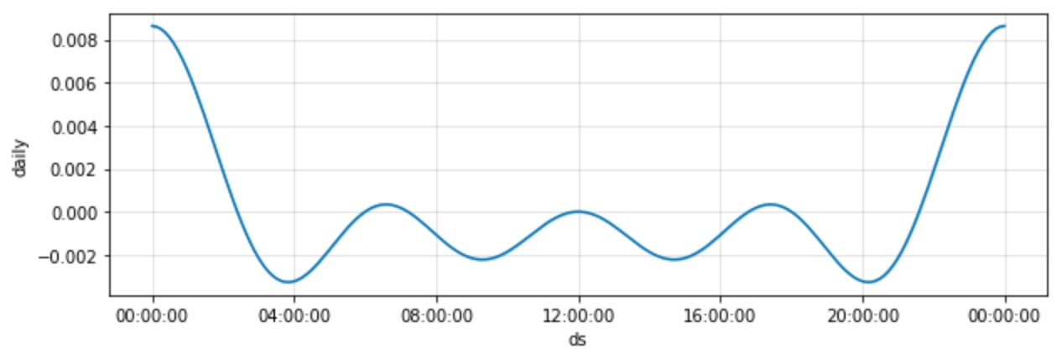
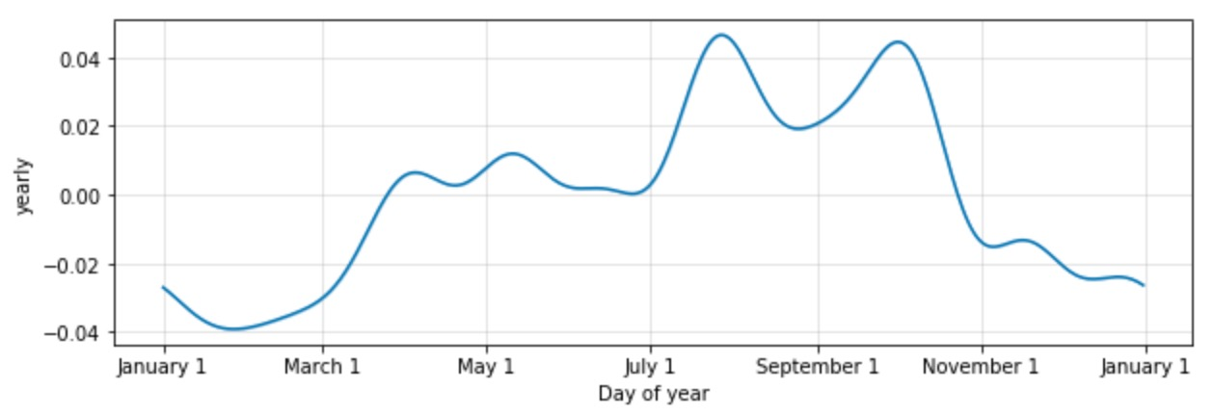
Data Exploration - Extracting Components
Result from Facebook Prophet
Time series components:
Overall Trend
Daily Seasonality
Weekly Seasonality
Yearly Seasonality

Slide 6
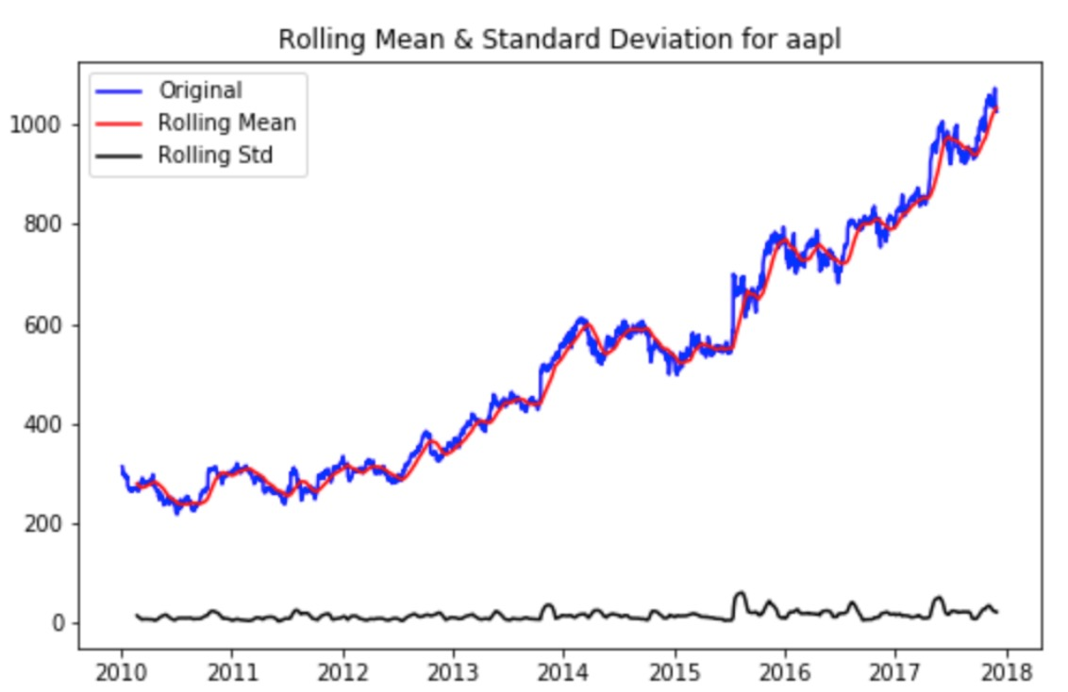
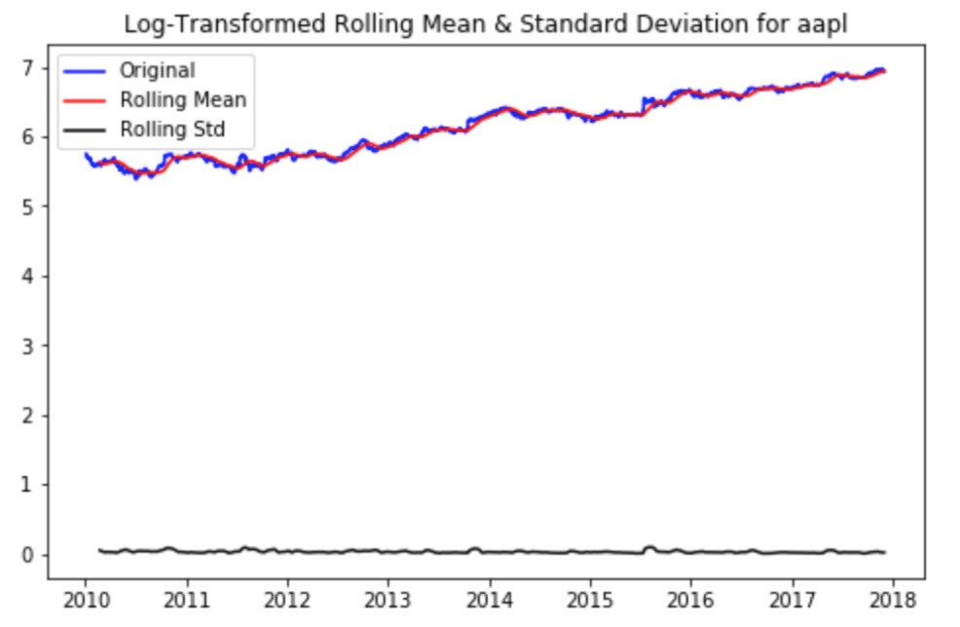
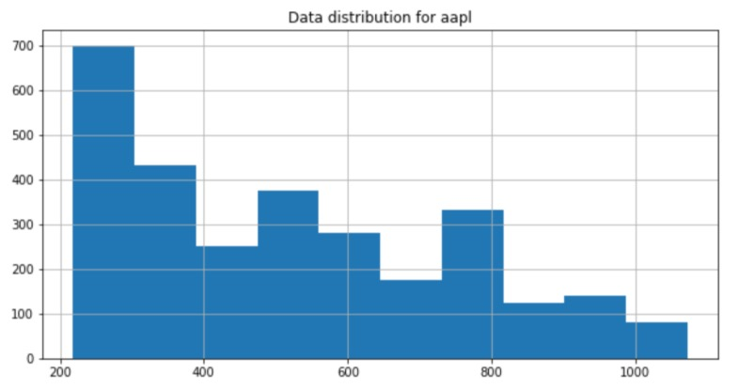
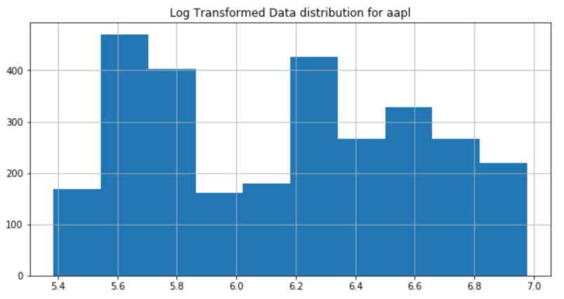
Data Exploration – Check Non-stationarity
Results from ARIMA
Non-Stationarity Analysis

Slide 7
Data Preprocessing
Interpolating Missing Dates: Add rows and impute values for weekends
Feature Selection: Remove Highly correlated Columns
Feature Engineering: Add features derived from closing price
Combine Datasets: Add features from S&P 500 to original stock data
Non-Stationarity Removal: log transformation

Slide 8
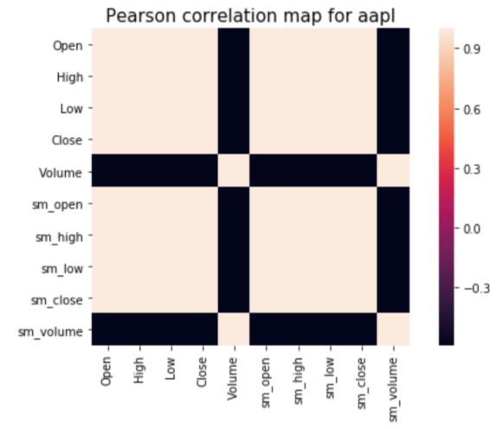
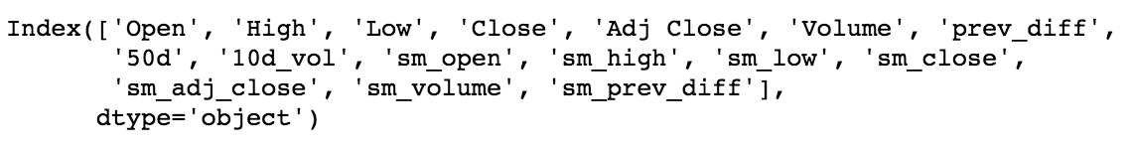
Feature Engineering
Correlation matrix | heat map
Open, High, Low, and Close are highly correlated
Add derived features
Final Feature Set:

Slide 9
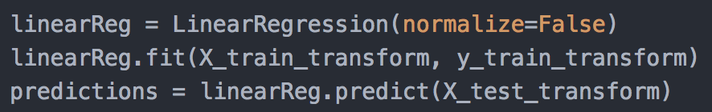
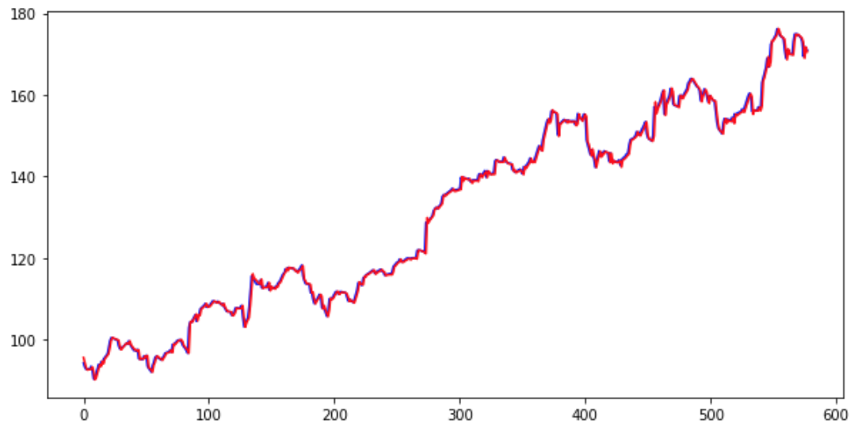
Linear Regression
MSE: 1.430

Slide 10
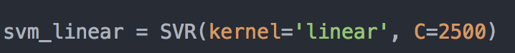
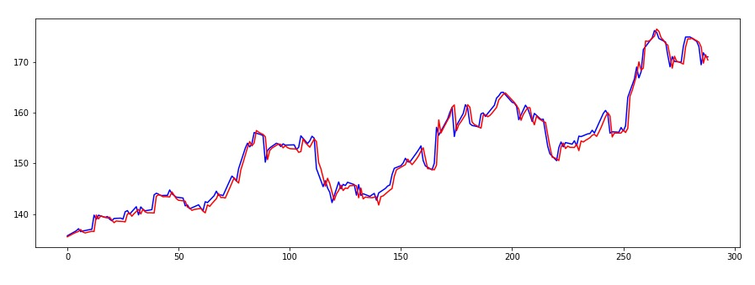
Support Vector Regressor (SVR)
MSE: 2.065

Slide 11
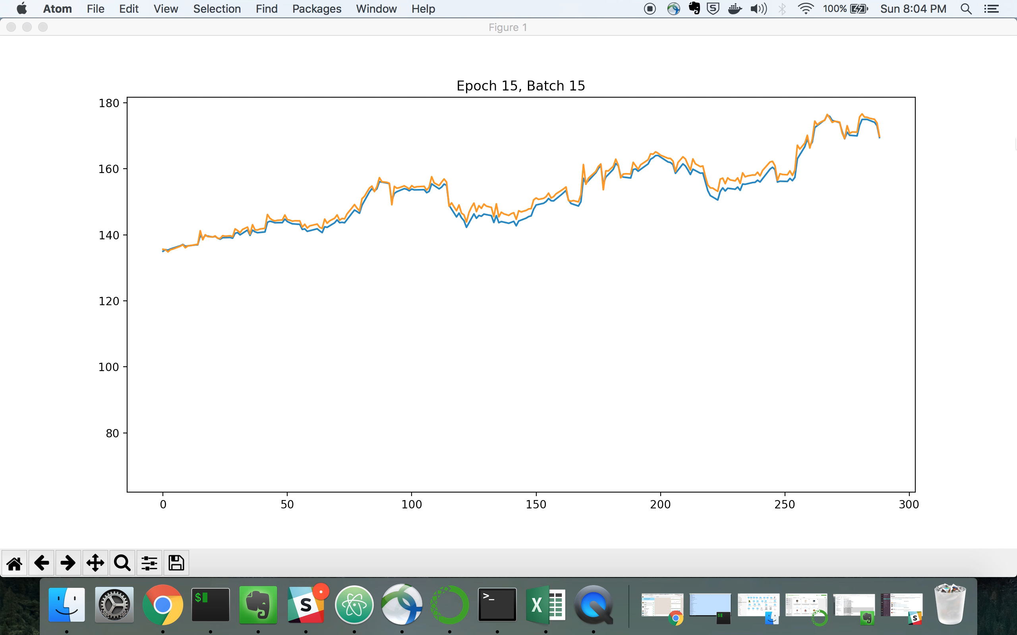
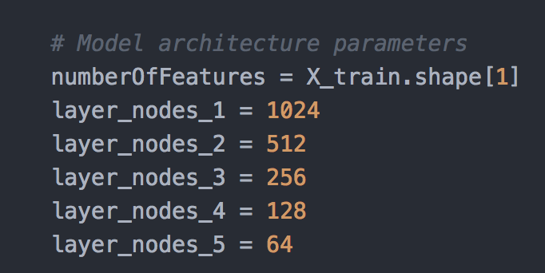
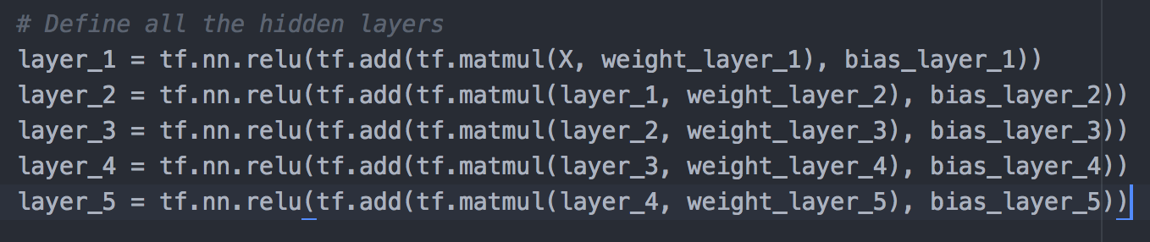
Artificial Neural Networks
MSE: 0.638

Slide 12
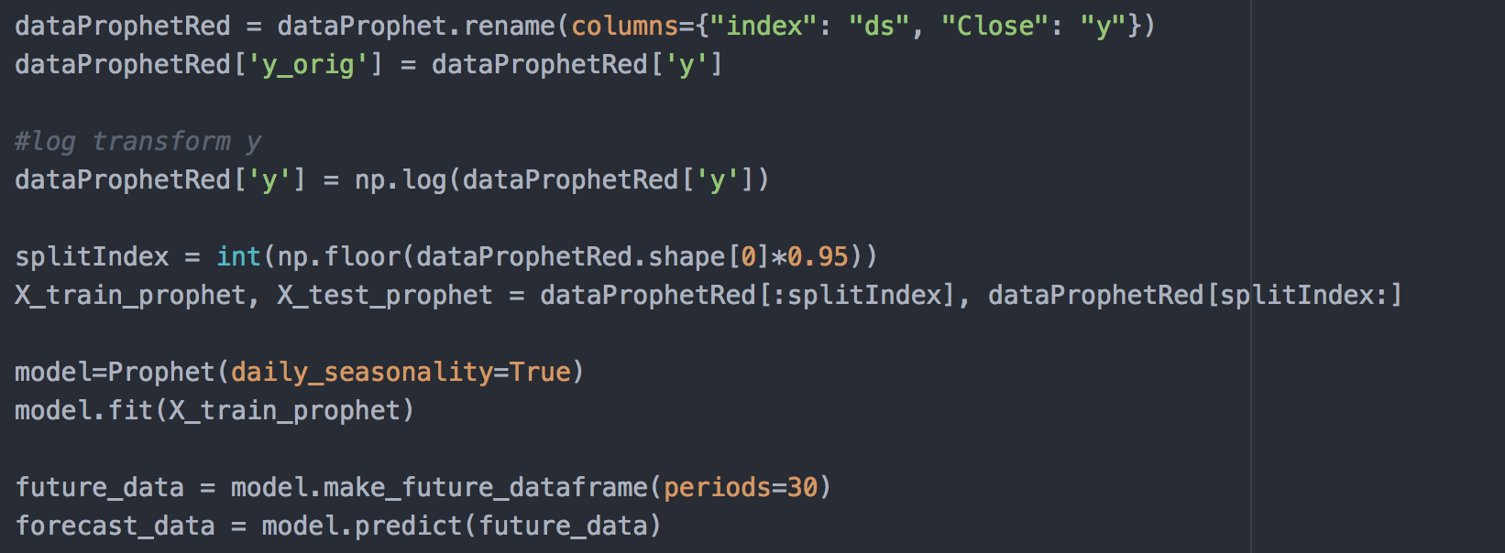
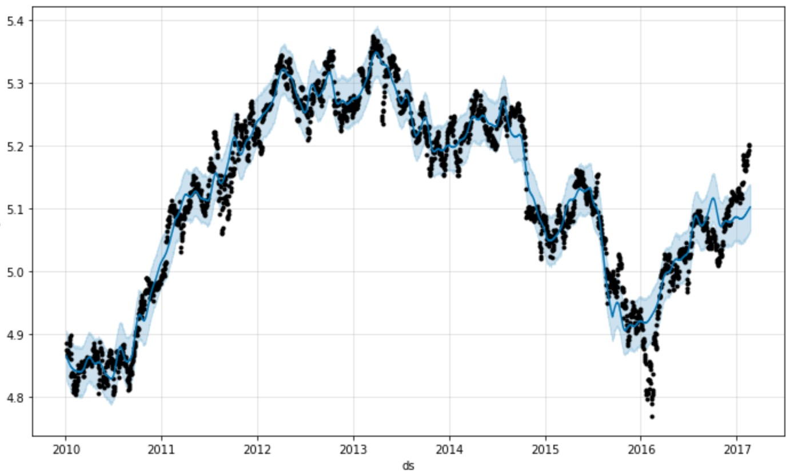
Facebook Prophet
MSE: 1639.284

Slide 13
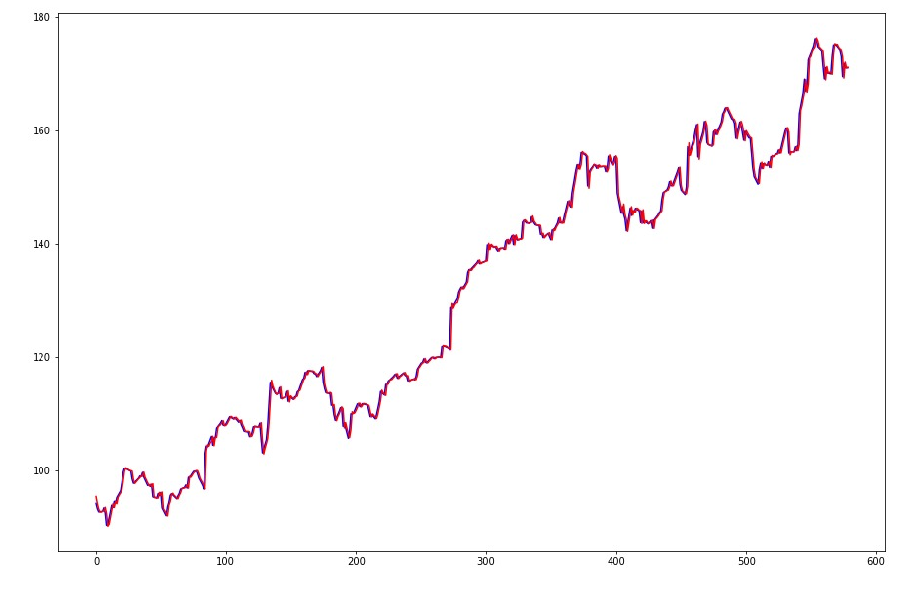
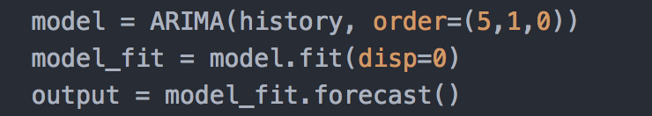
ARIMA
MSE: 1.493

Slide 14
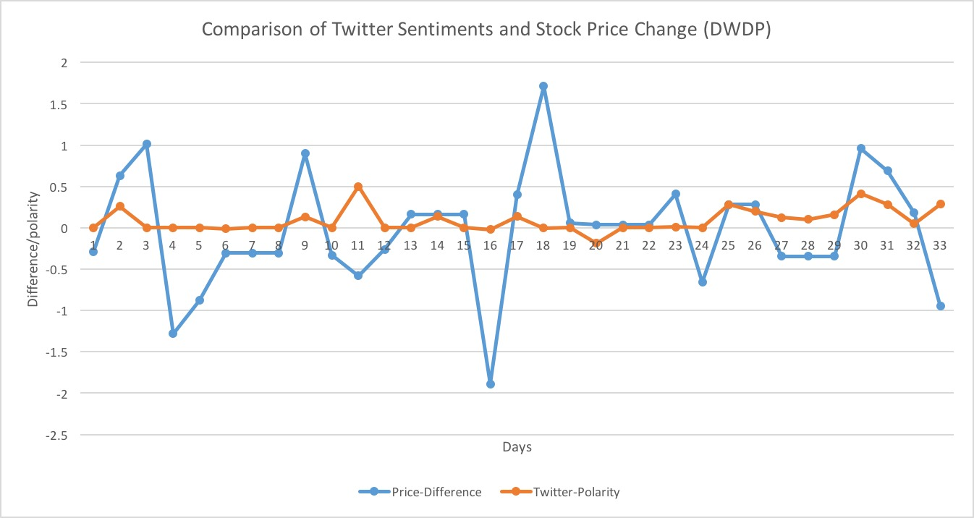
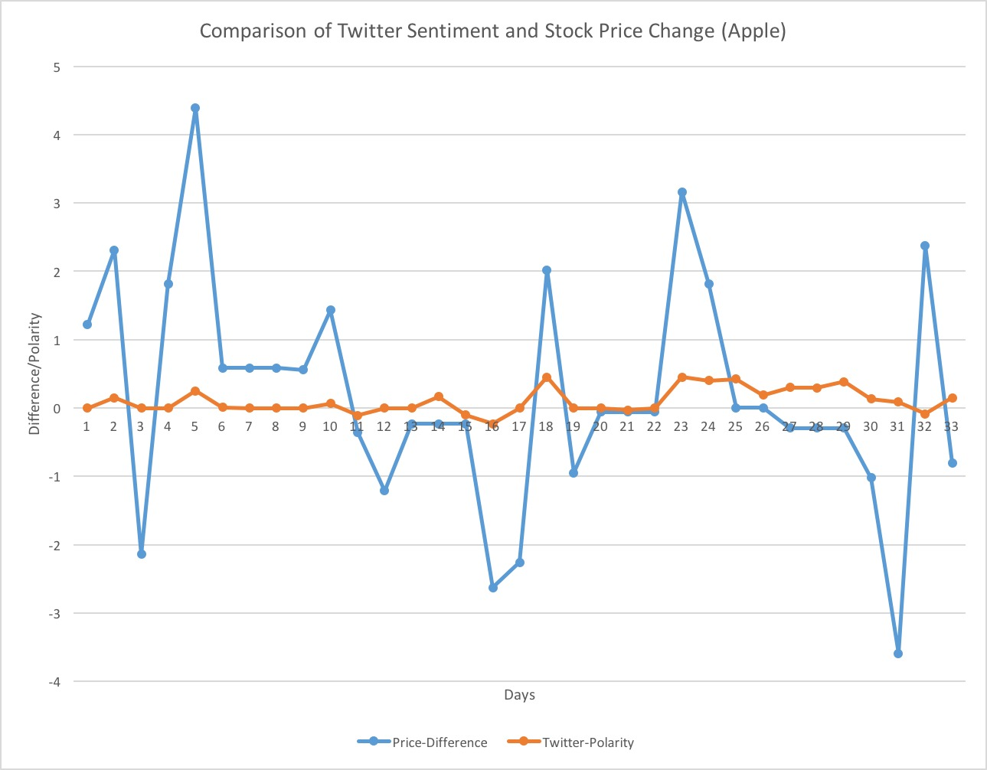
Inference – Twitter Sentiment analysis
Stock price time series showed considerable correlation with Twitter sentiments
Twitter sentiments can be used as extra feature in future to improve performance

Slide 15
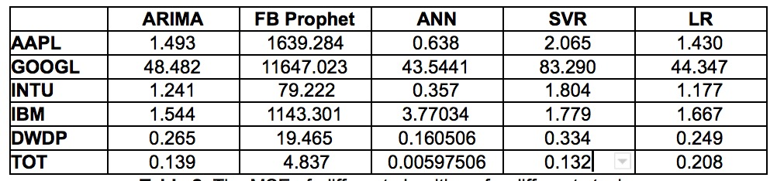
Results
ANN yielded the best performance, followed closely by ARIMA

Slide 16
Conclusion
Adding the new features i.e. 10 day volatility, 50 day moving average, difference helped
Combining the features from S&P dataset improved performance
Interpolation of data for weekends helped in maintaining time series data continuity
Stock price time series showed considerable correlation with Twitter sentiments, so it can be used as a feature for Stock Price Prediction
Twitter data was found to be insufficient to be used as a feature for price prediction and hence, was instead used for inference

